Slide 1
Transaction Monitoring Program – xID Rule Optimization
June 08, 2020

Slide 2
xID Rule ATL/BTL:
Purpose: To apply the ATL/BTL to the xID rule to ensure rule optimization
Plan:
To identify 2.0 sellers within the 85th, 75th, and 65th percentile of the initial rule population
X: Number of 2.0 users with at least 1 linked account
Y: Total GMV between linked accounts
Period of review: Last full calendar year
Analysis:
After the initial population and thresholds have been assigned an analysis will be conducted to confirm the accuracy of the monitoring rule logic.
ATL/BTL analysis will also be conducted to determine the risk associated with the initial threshold and any alerts that may be omitted by such threshold.

Slide 3
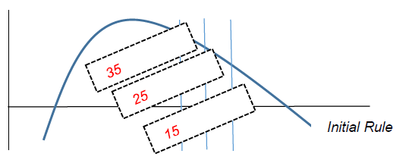
X= # of linked accounts
Y= Total GMV between linked accounts

Slide 4
Step 1: Linked Accounts– Suppose A and D are P2.0 Sellers
User Id | Linking
A | 123@ebay.com
b | 123@ebay.com
A | 250 Cheery Ave
c | 250 Cheery Ave
A has 2 linked Accounts : b & c
User Id | Linking
D | cat@ebay.com
e | cat@ebay.com
D | 900 Melon Street
f | 900 Melon Street
D also has 2 linked Accounts : e & f

Slide 5
Step 2: Calculate Avg GMV per Seller and then Aggregate
Seller | Buyer | GMV (Completed Trans)
A | b | $ 1
A | b | $ 100
A | c | $ 10
D | e | $ 20
D | f | $ 30
Seller | Avg. GMV between linked account
A | (($ 1 + $ 100) + $ 10) /2 = $15
D | ($20 + $ 30) /2 = $ 25
Step 3: Getting X and Y
# of linked accounts
y1 = 2, x1 = 15
y2 = 2 , x2= 25
Total GMV

Slide 6
Current Data Feeds/Progress:
Total P2.0 Sellers: 41,610
Total P2.0 Sellers who has at least one linked account : 33,352
Total P2.0 Sellers who has at least 1 linked account and done at least 1 transactions between linked account: 369
Total GMV between sellers and their linked accounts last year: $ 64,969.92
Max GMV/Transaction between linked account: $342.54

Slide 7
Current Data Feeds/Progress:
Distribution: number of sellers who has N amount of linked account that conducted at least one transaction during last year
# of linked accounts (X) | # of sellers
1 | 333
2 | 30
3 | 4
4 | 1
8 | 1
Only have 5 data inputs for X and Y :
Where :
X=1, 2, 3, 4, 8
Most data available when # of linked account = 1

Slide 8
Next Step

